Slide 1
EMBA 756 Class 60 Littlefield Labs: Team Performance May 2025

Slide 2
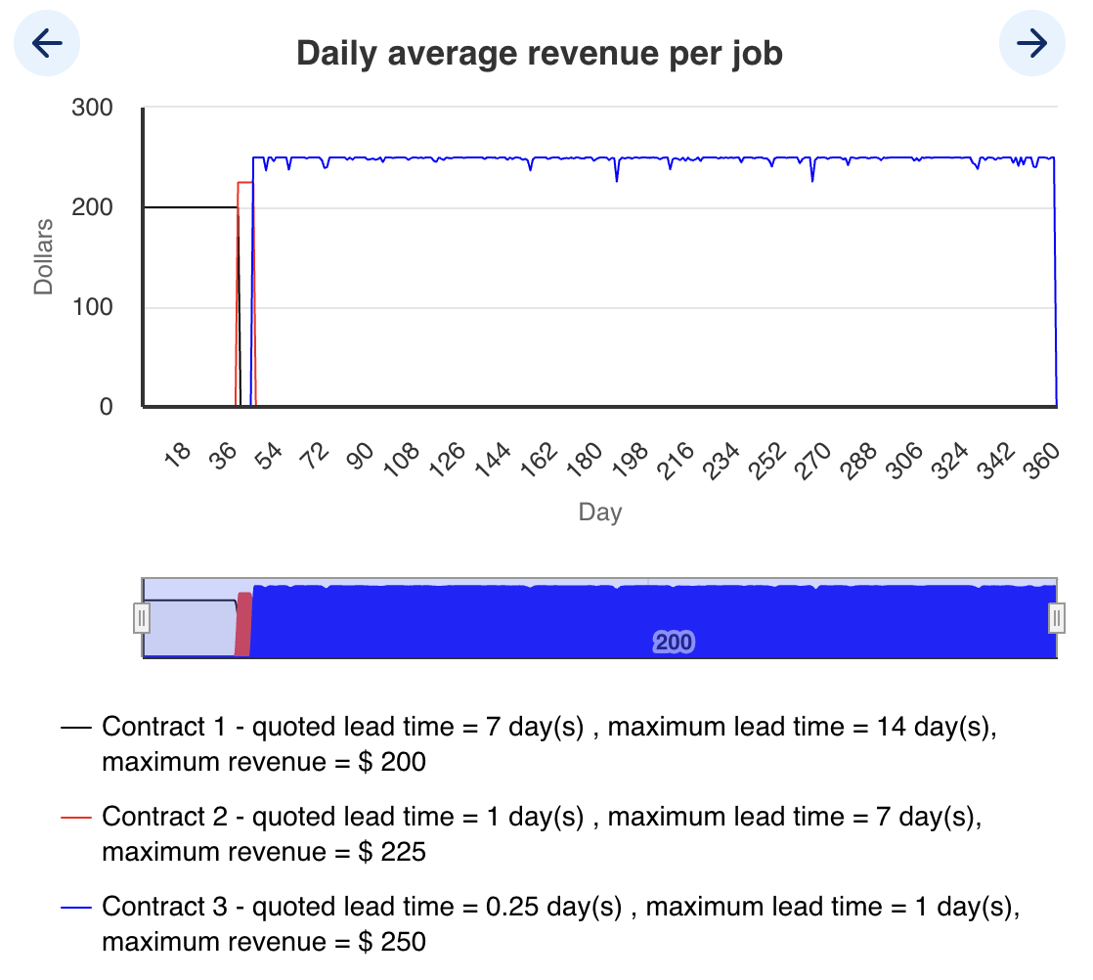
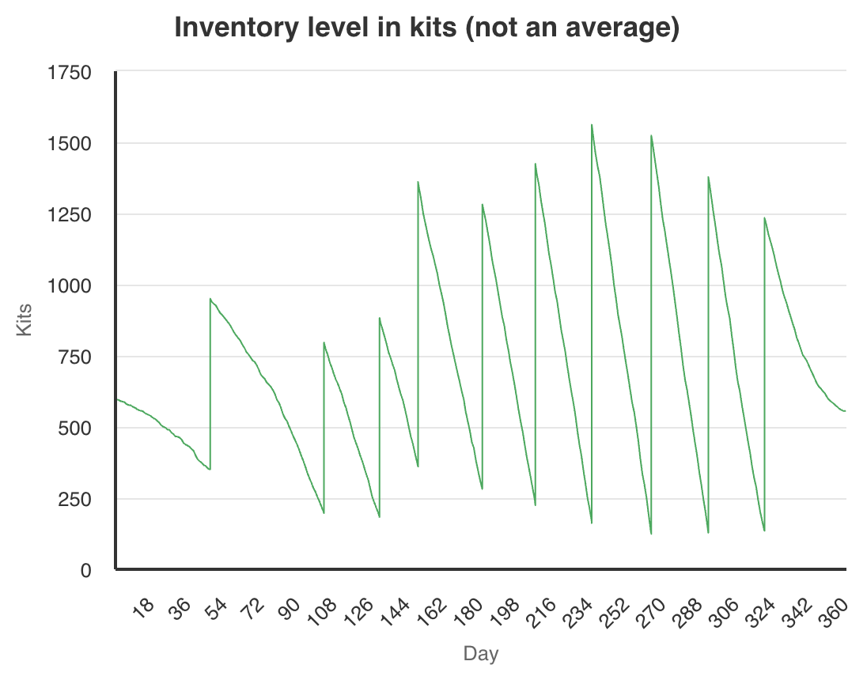
Team A (Best Performance!)
Cash: $1 775 686
S1: 1 → 7 (149) → 9 (218) → 8 (315) → 1 (360)
S2: 1 → 3 (156) → 1 (343)
S3: 1 → 2 (217) → 1 (317)
1. Capacity Management
- S1: Util > 95 % by day 22 but didn’t add until day 149—should have added at 7-day avg util > 90 % (~day 22). After peaking, late sell-offs (day 315, util < 70 %) could have been trimmed sooner.
- S2: Util < 75 % until mid-run; add 2→3 at day 156, sell when util < 50 % (~day 300).
- S3: Added at day 217 when util < 40 %—delay until util > 90 % would have avoided an idle machine.
2. Contract Strategy
- Switched to C3 ($250/job) by day 44; early S1 shortage (days 1–149) limited C3 fill. Selling S1 capacity around day 250 instead of shifting to C2 could have extended high-margin C3 run.
3. Inventory Performance
- No stockouts (Kits never hit zero).
- Leftover ≈ 556 kits (~$55,600)
Inventory
Revenue

Slide 3
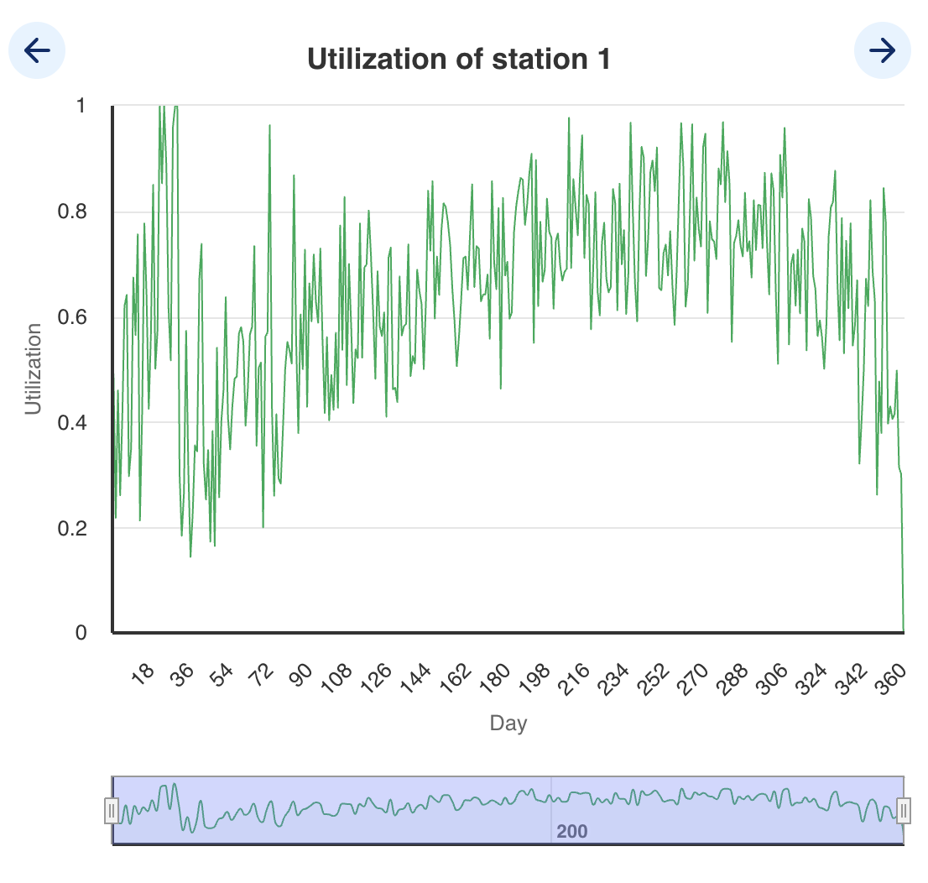
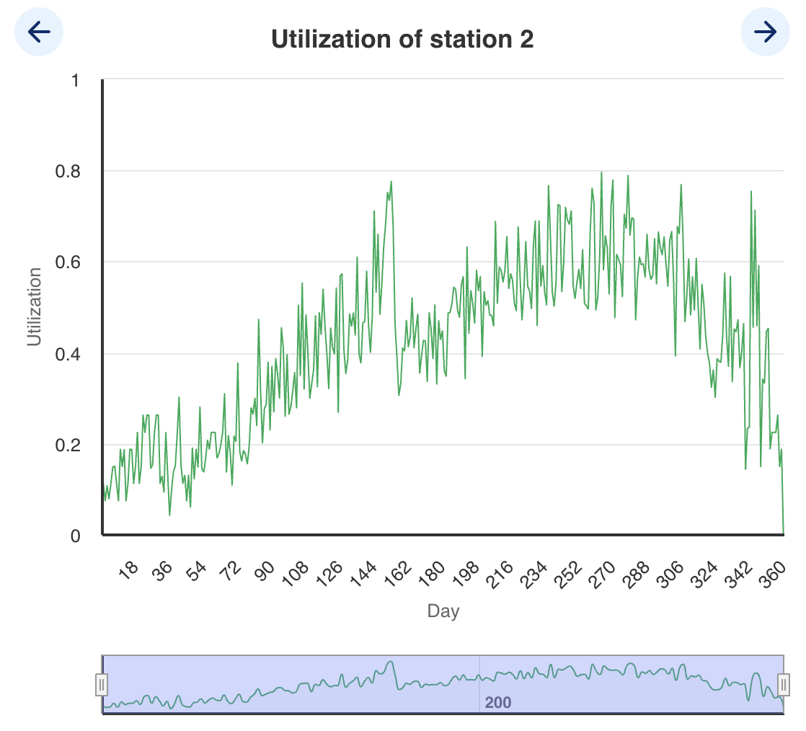
Utilization
Station 1
Station 2

Slide 4
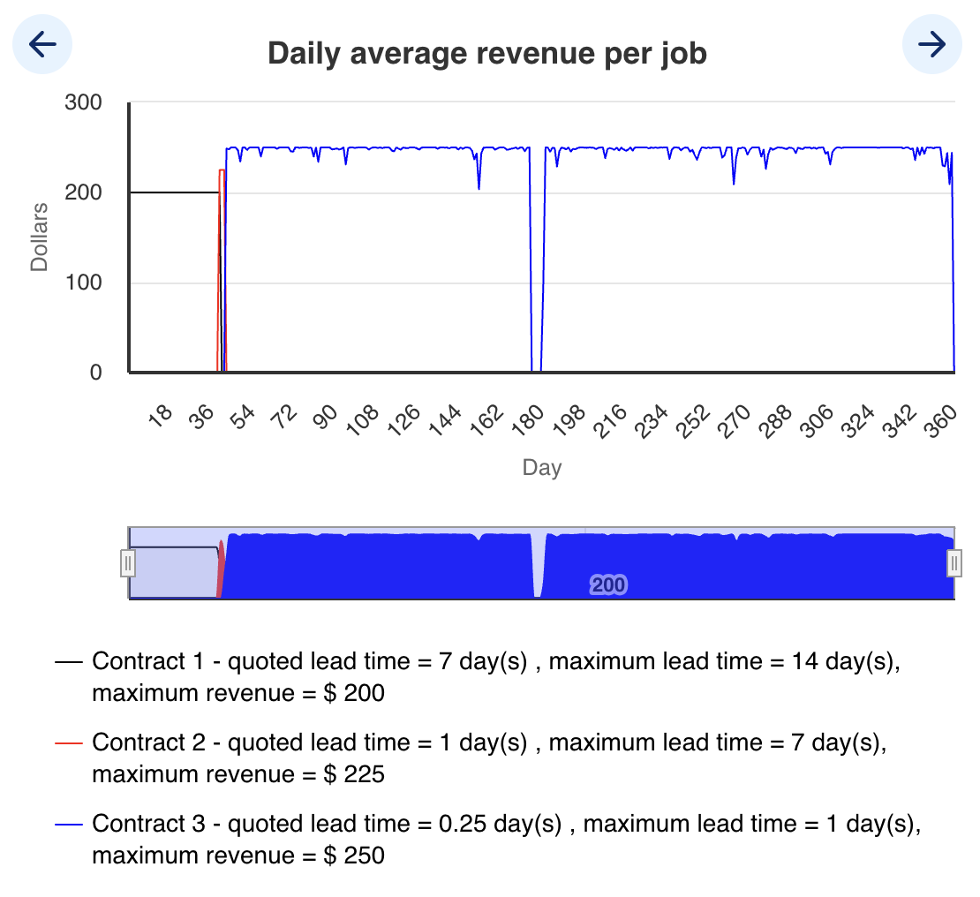
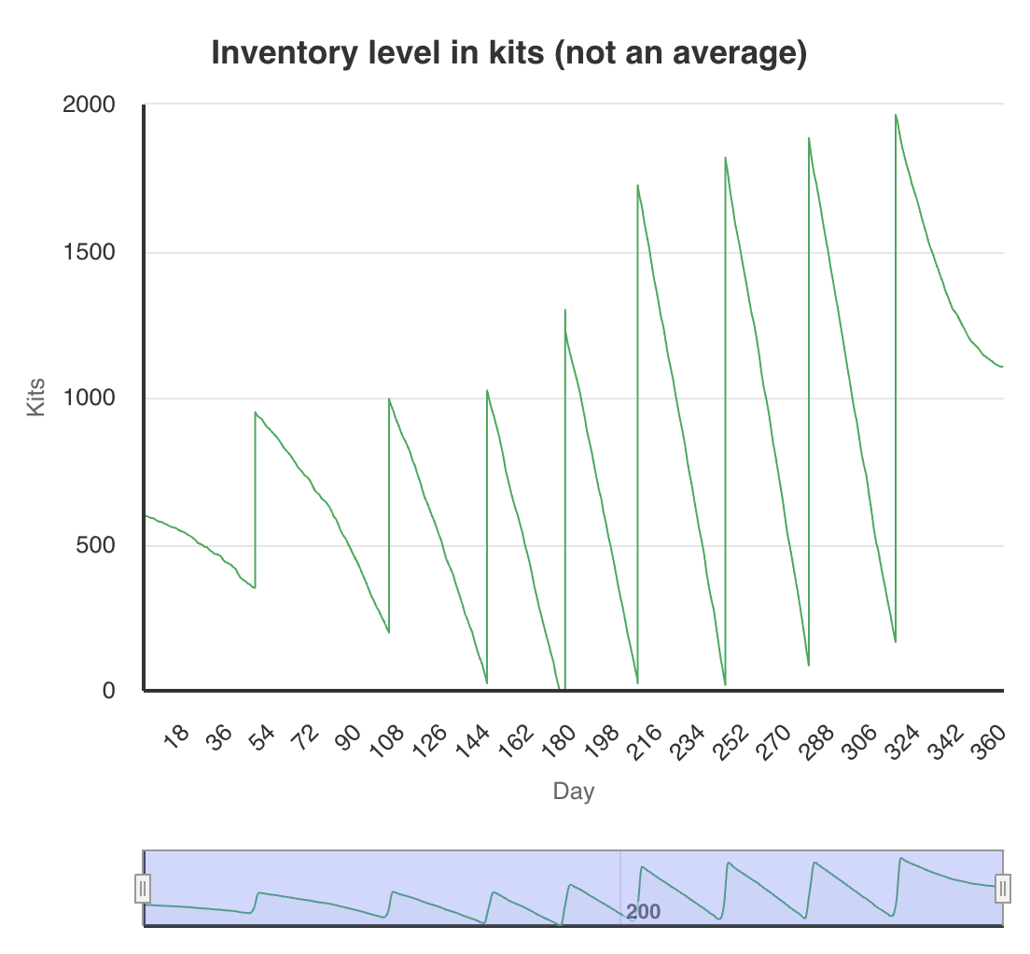
Team B (6th place)
Cash: $1,615,687
S1: 1 → 2 (day 33) → 3 (day 38) → 4 (day 39) → 5 (day 97) → 6 (day 130) → 7 (day 156) → 8 (day 163) → 9 (day 220) → 10 (day 233) → 11 (day 254) → 10 (day 328) → 8 (day 329) → 7 (day 334) → 5 (day 338) → 3 (day 343) → 2 (day 354) → 1 (day 355)
S2: 1 → 2 (day 86) → 3 (day 196) → 2 (day 331) → 1 (day 340)
S3: 1 → 2 (day 218) → 1 (day 235)
1. Capacity Management
- S1: util >95% by day 22 but ramped 1→11 too fast—should add one at util >90% (~day 20) and trim when util <70% (~day 260).
- S2: add at util >80% (~day 86), sell when util <40% (~day 330).
- S3: added at util <60%—should add only if util >90% (never reached).
2. Contract Strategy
Switched to C3 ($250/job) by day 42; early S1 shortage (days 1–33) forced some C2/C1 fills. Maintaining two S1 machines by day 20 would support uninterrupted C3 until day 175.
3. Inventory Performance
- Stockouts around days 174.7–176.9 during peak C3 demand.
- Leftover ≈1 106 kits (~$110,600)
Revenue
Inventory

Slide 5
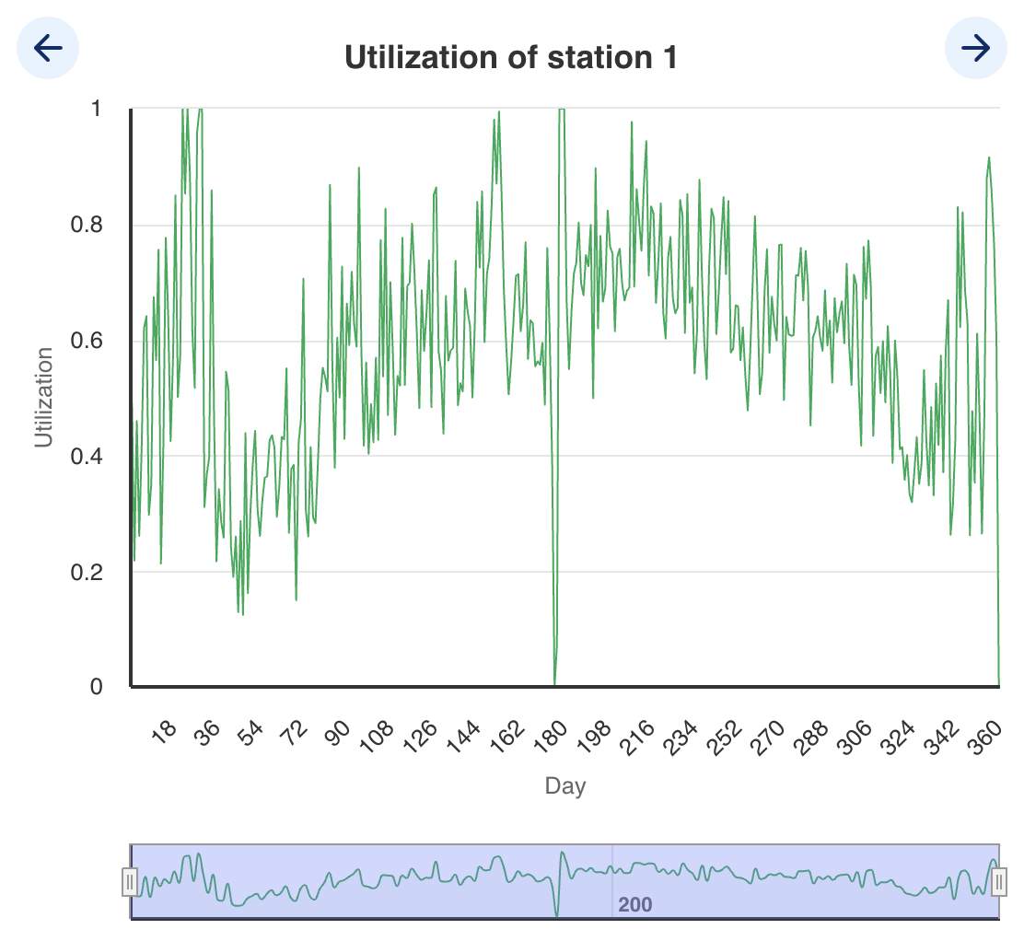
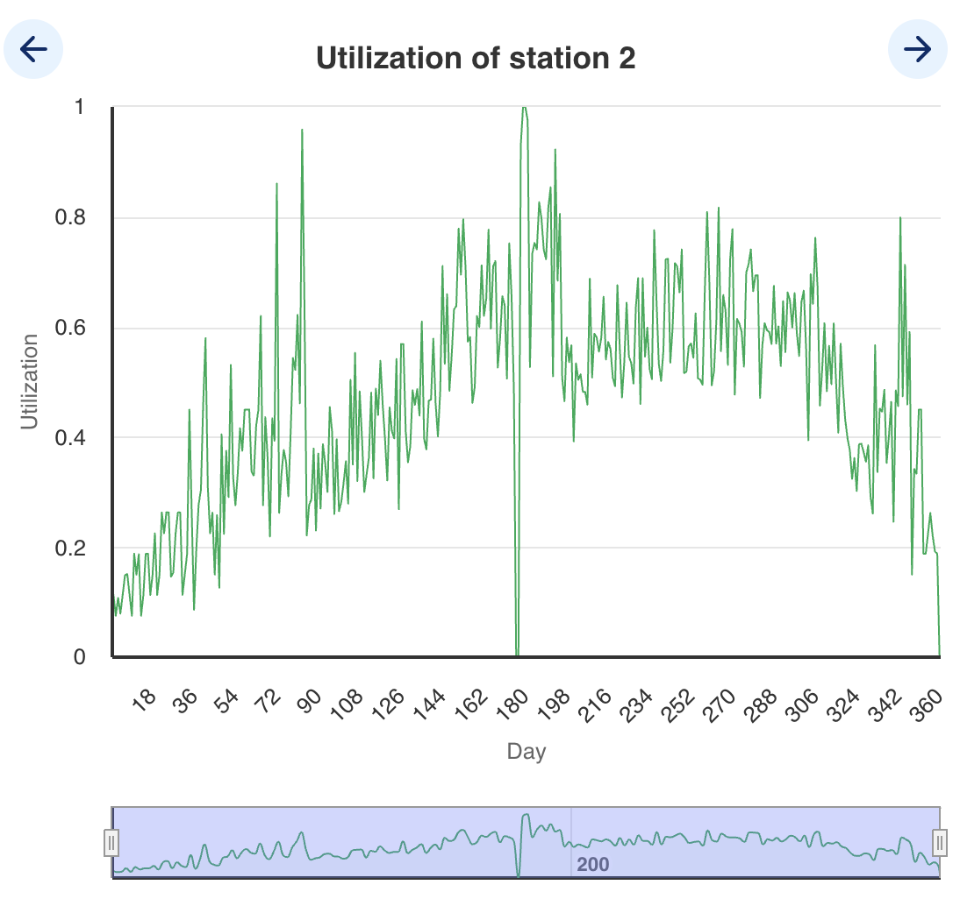
Utilization
Station 1
Station 2

Slide 6
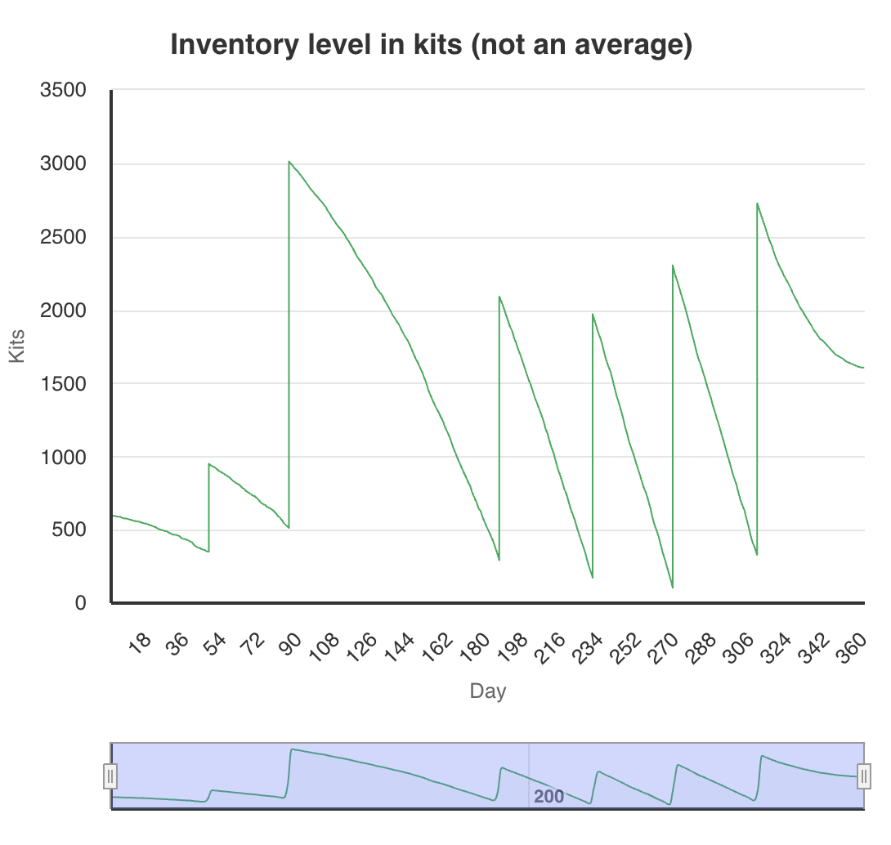
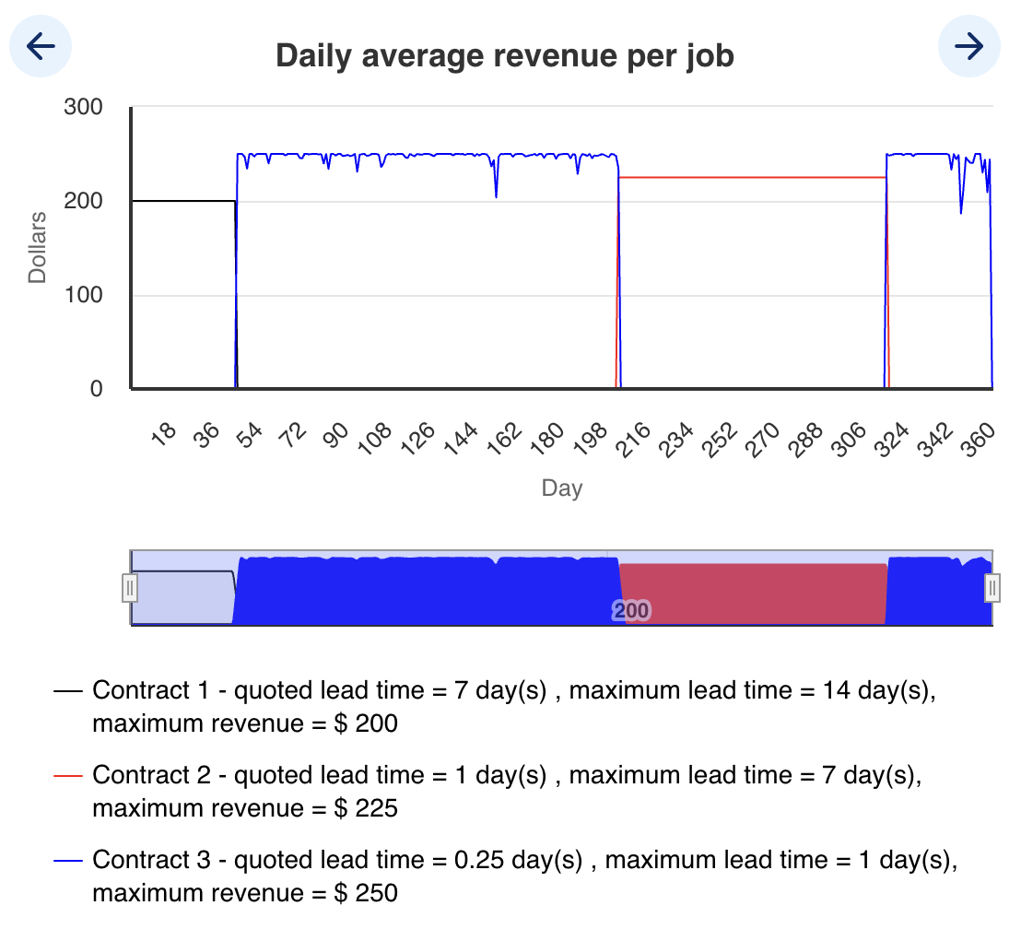
Team C (5th place)
Cash: $1,684,329
S1: 1 → 4 (day 43) → 5 (day 107) → 6 (day 129) → 7 (day 154) → 8 (day 157) → 7 (day 337) → 4 (day 344) → 2 (day 347) → 1 (day 356)
S2: 1 → 2 (day 87) → 1 (day 343)
S3: 1 (no changes)
1. Capacity Management
- S1: util >90% by day 22 but no add until day 43; should add 2nd machine when 7-day avg util >90% (~day 20); late sell-offs (days 337–356) lagged avg util <70%—trim earlier.
- S2: added 2nd at day 87 when util ~80%; no 3rd needed; sold at day 343 when util <40%.
- S3: one machine sufficed (util <70%); no change required.
2. Contract Strategy
- Switched to C3 ($250/job) by day 45; early S1 under-capacity limited C3 fill. Pivot to C2 at day 187 was prudent.
3. Inventory Performance
- No stockouts (Kits never hit zero).
- Leftover ≈ 1,606 kits (≈ $160,600)
Inventory
Revenue

Slide 7
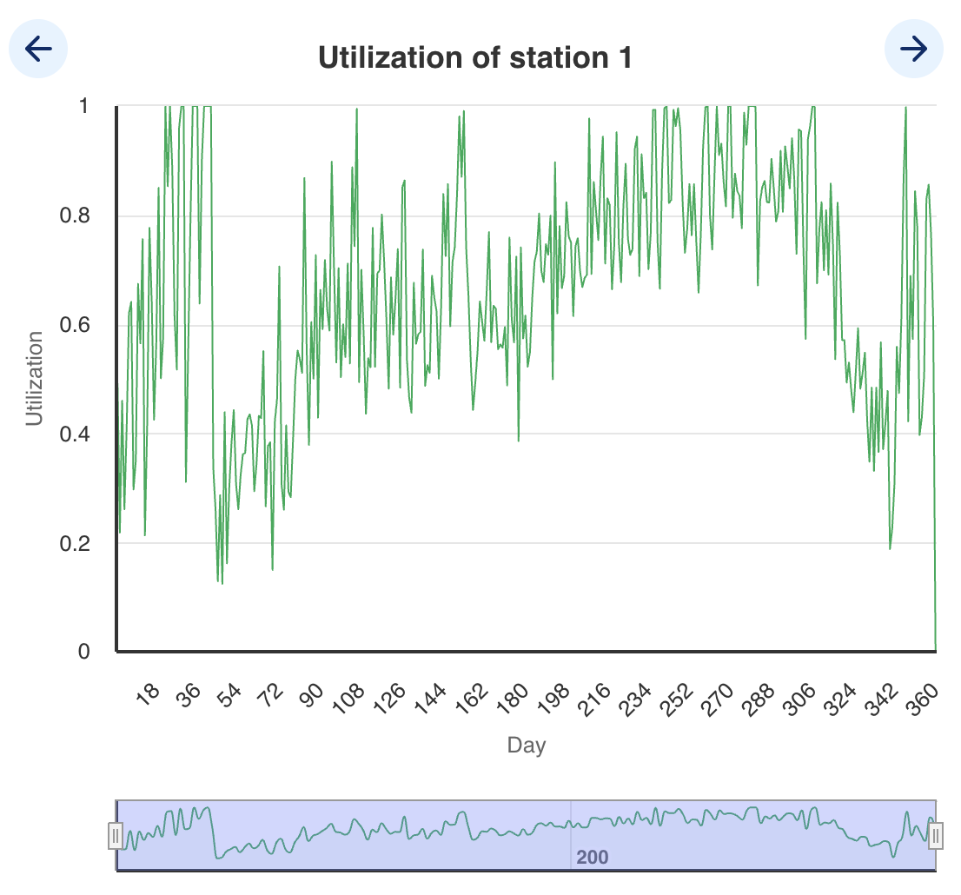
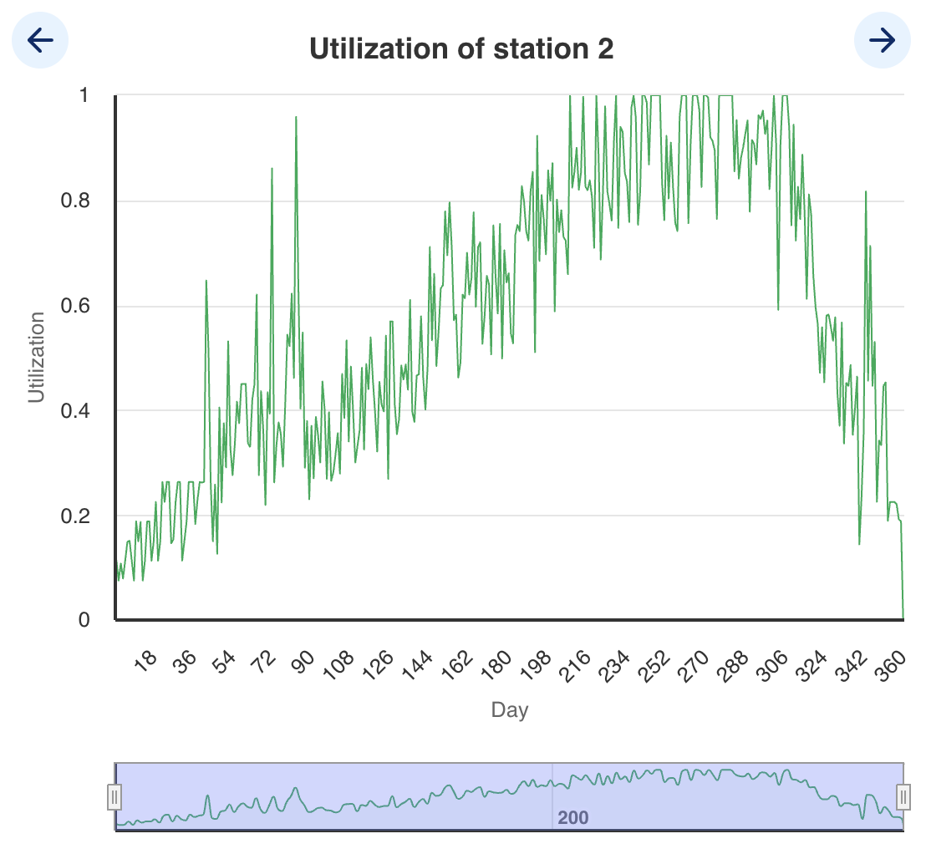
Utilization
Station 1
Station 2

Slide 8
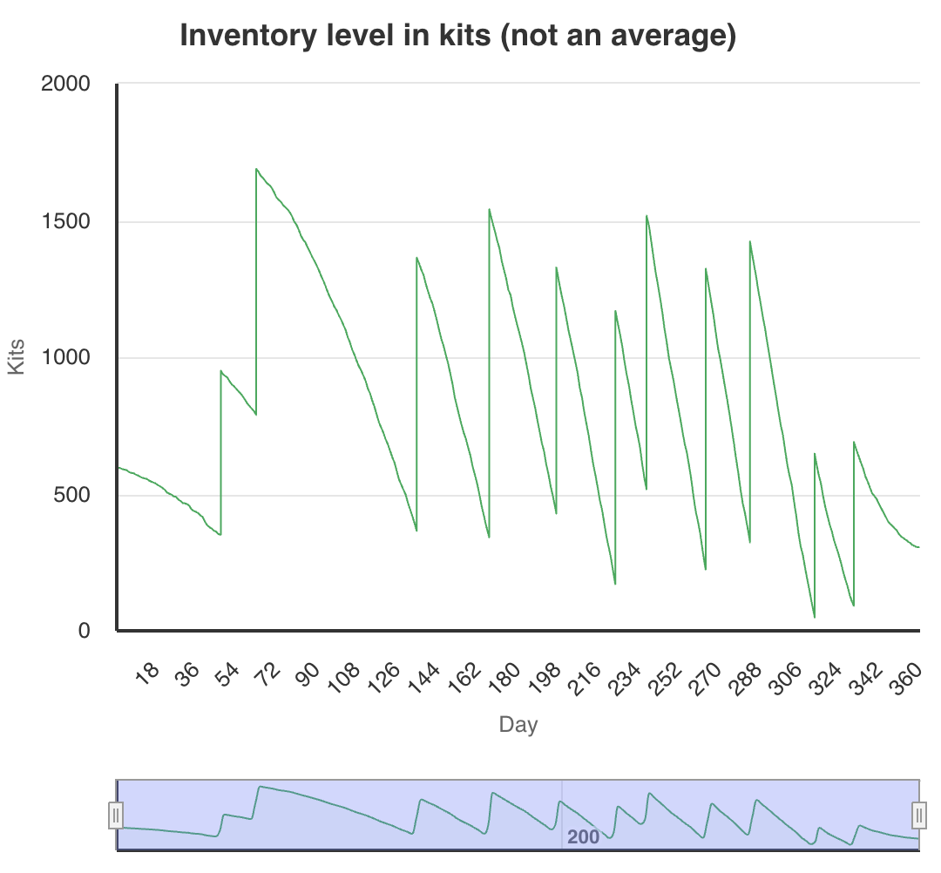
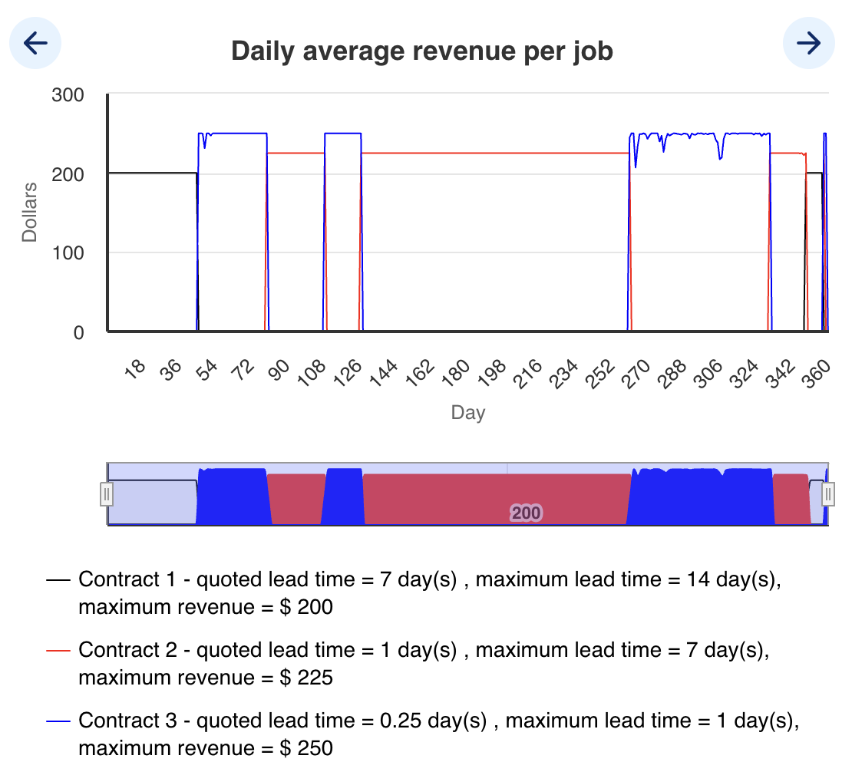
Team D (3rd place)
Cash: $1,701,802
S1: 1 → 2 (32) → 3 (40) → 4 (51) → 5 (56) → 6 (85) → 7 (109) → 8 (148) → 9 (264) → 8 (301) → 7 (323) → 6 (325) → 5 (333) → 4 (335) → 3 (337) → 2 (343) → 1 (360)
S2: 1 → 2 (55) → 3 (152) → 2 (321) → 1 (335)
S3: 1 (no changes)
1. Capacity Management
- S1: util >90% by day 20 but first add at day 32—should add when 7-day avg util >90% (~day 20). Subsequent adds tracked demand; late sell-offs post-day 300 (util <50%) could be moved earlier.
- S2: add @ util ~80% (day 55) and 3rd @ day 152; sell @ util <40% (day 335).
- S3: util <70% throughout; one machine sufficed.
2. Contract Strategy
- Moved to C3 ($250) by day 50, switched to C2 ($225) at day 90, back to C3 at day 110, then C2 @ day 260, C1 @ day 358.
3. Inventory Performance
- Leftover ~300 kits (~$30,000k)
Inventory
Revenue

Slide 9
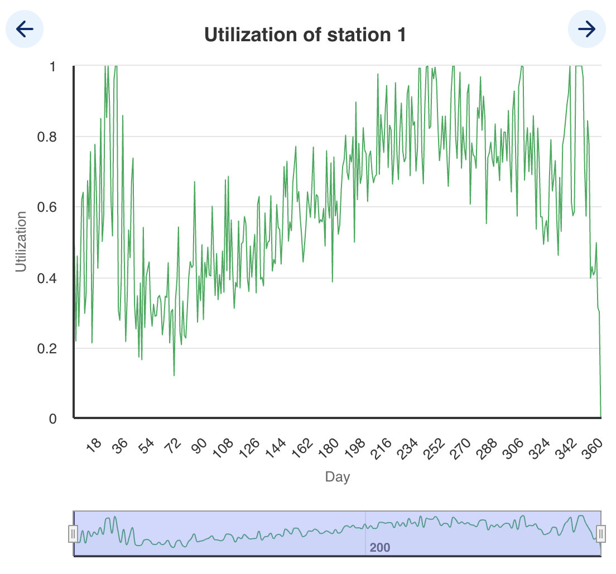
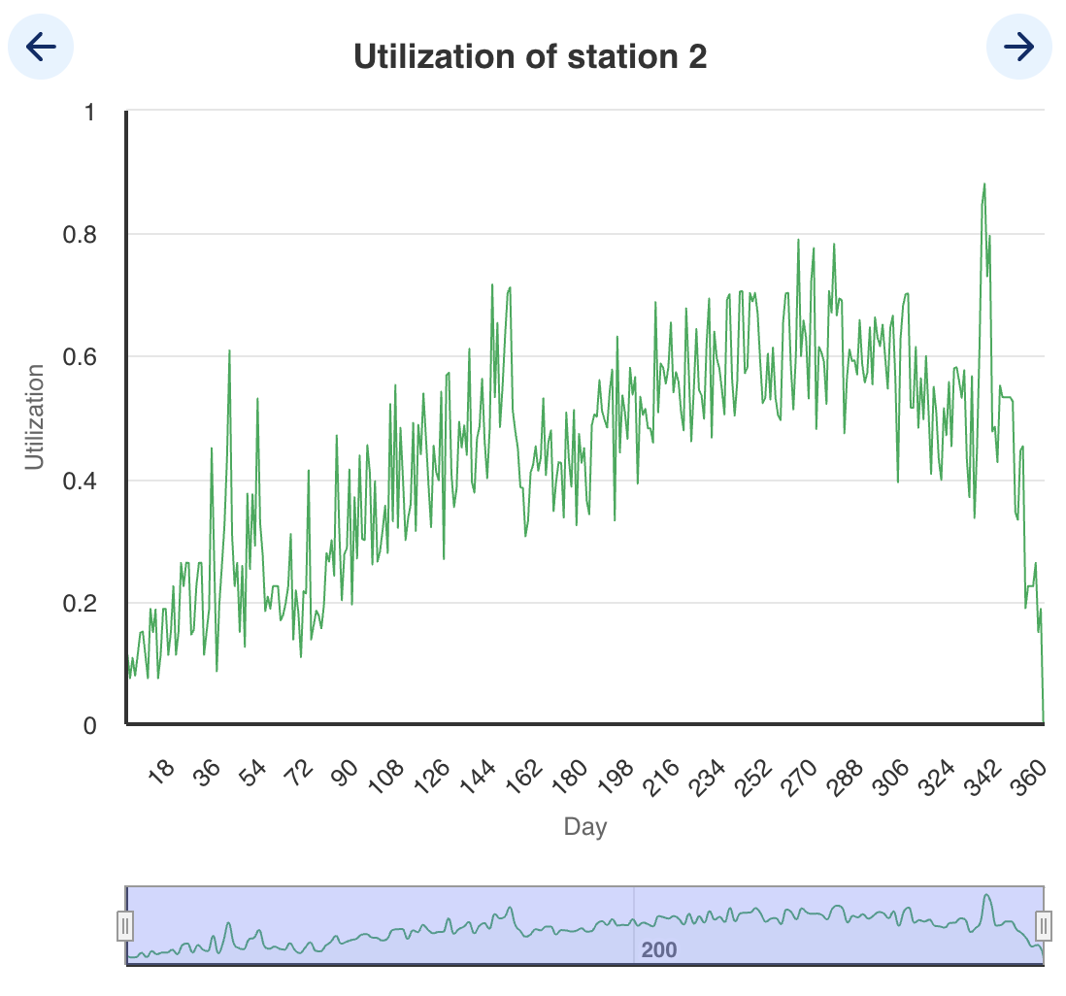
Utilization
Station 1
Station 2

Slide 10
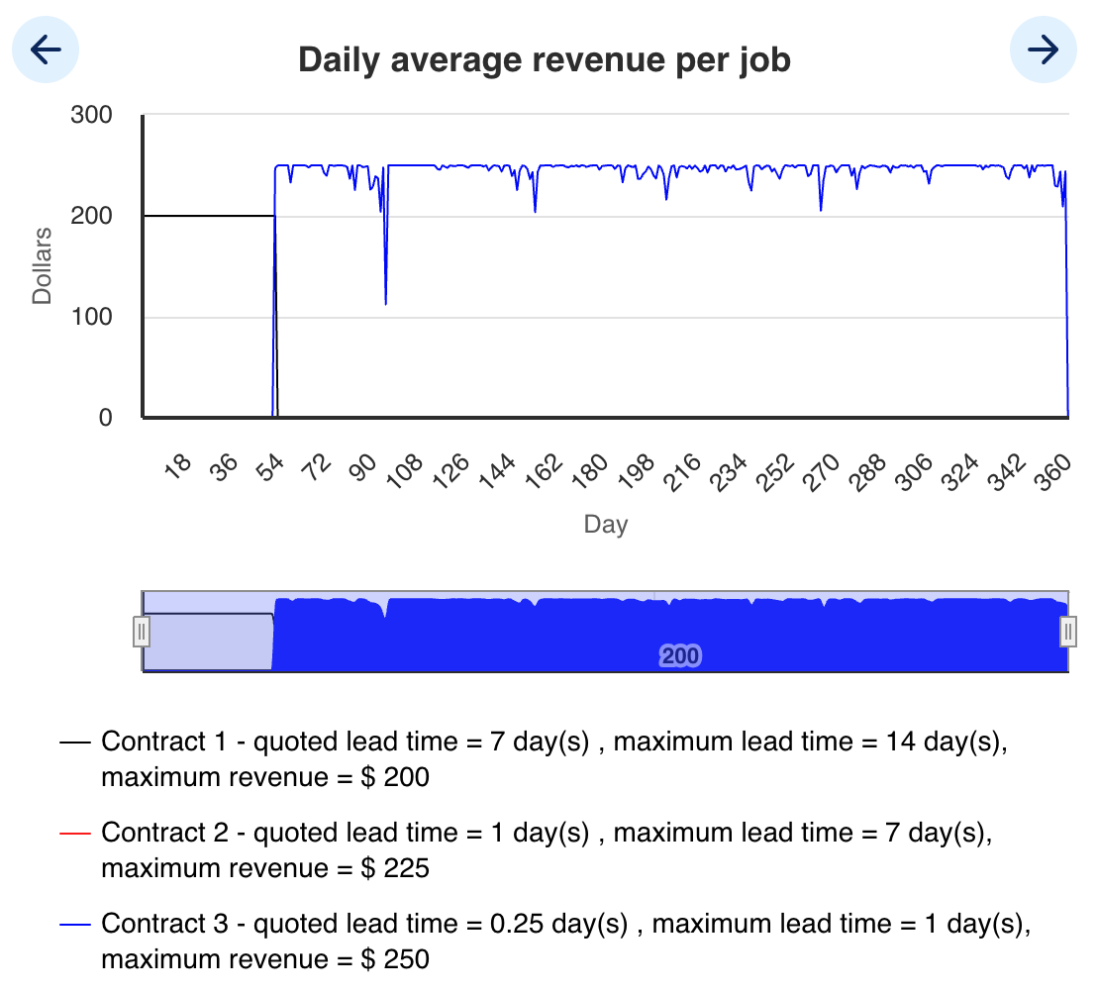
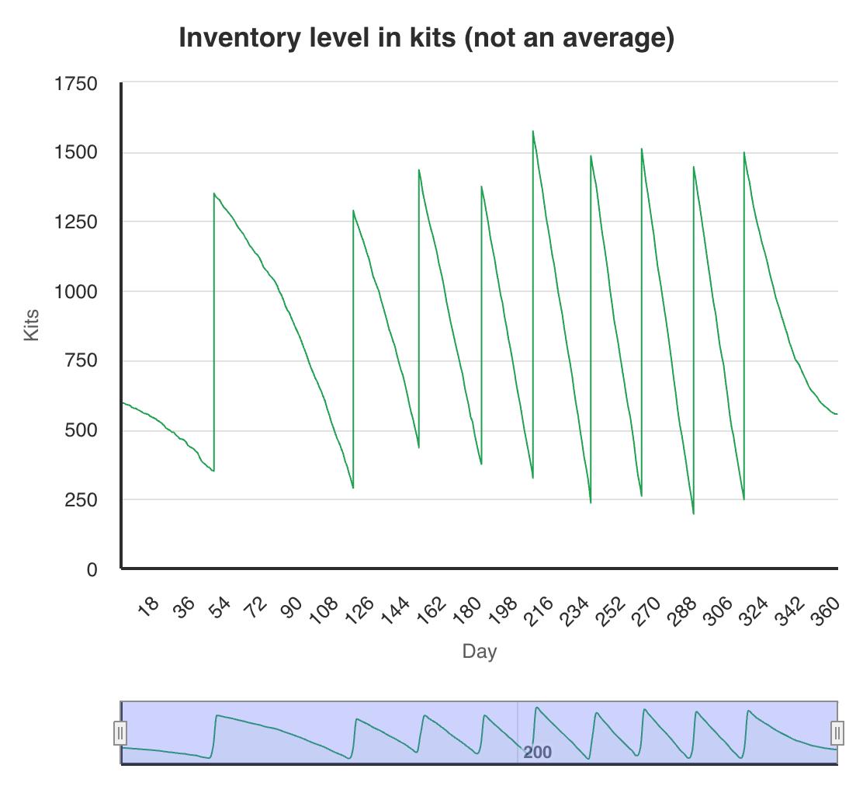
Team E (2nd place)
Cash: $1 760 731
S1: 1 → 4 (day 37) → 5 (day 38) → 7 (day 41) → 8 (day 42) → 6 (day 70) → 5 (day 112) → 6 (day 149) → 7 (day 156) → 8 (day 157) → 9 (day 239) → 8 (day 323) → 6 (day 324) → 4 (day 334) → 3 (day 349) → 2 (day 353) → 1 (day 354)
S2: 1 → 2 (day 96) → 3 (day 208) → 2 (day 325) → 1 (day 343)
S3: 1 (no changes)
1. Capacity Management
- S1: Util > 90 % by day 20 but first add at day 37—should have added a 2nd machine around day 20 when 7-day avg util > 90 %. Subsequent adds (37, 38, 41, 42, … 239) tracked demand well. Sell-offs from day 323 (util < 70 %) could be moved earlier.
- S2: Added 2nd at day 96 (util ≈ 80 %), 3rd at day 208; sold back to one at day 343 (util < 40 %).
- S3: Util stayed < 70 % entire run; one machine sufficed.
2. Contract Strategy
- Stayed on C1 (200 $/job) through day 52, switched to C3 (250 $/job) at day 52, and ran exclusively C3 until the final day switch to C1. No C2 usage.
3. Inventory Performance
- Leftover ≈ 350 kits (≈ $35,000).
Revenue
Inventory

Slide 11
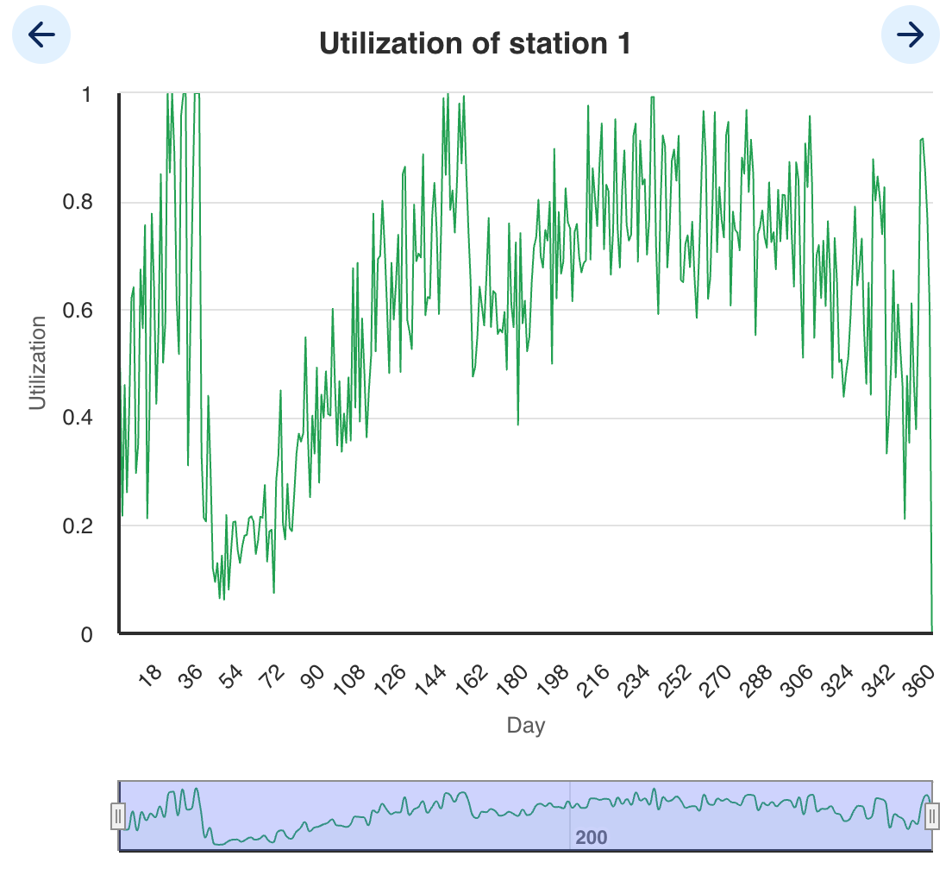
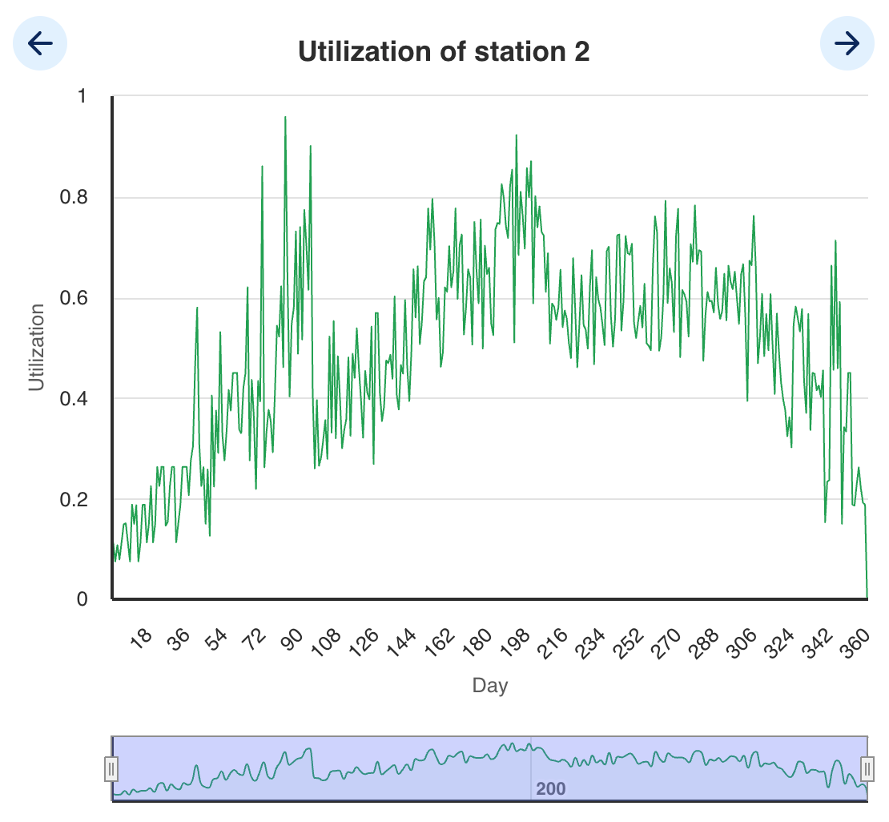
Utilization
Station 1
Station 2

Slide 12
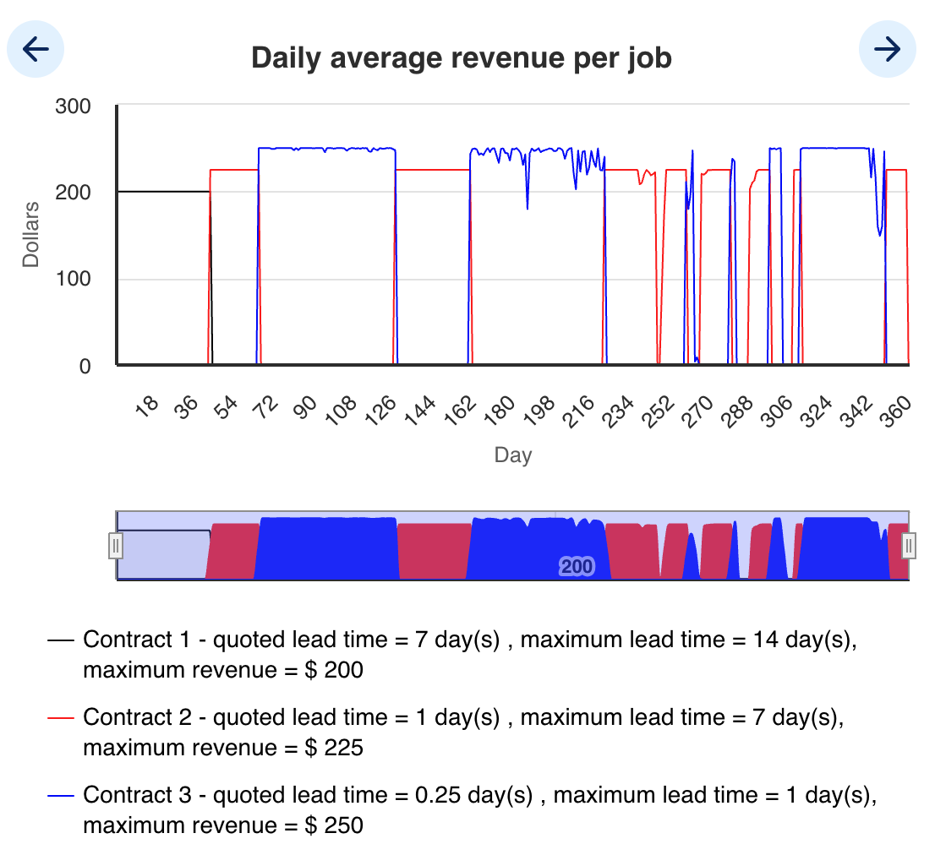
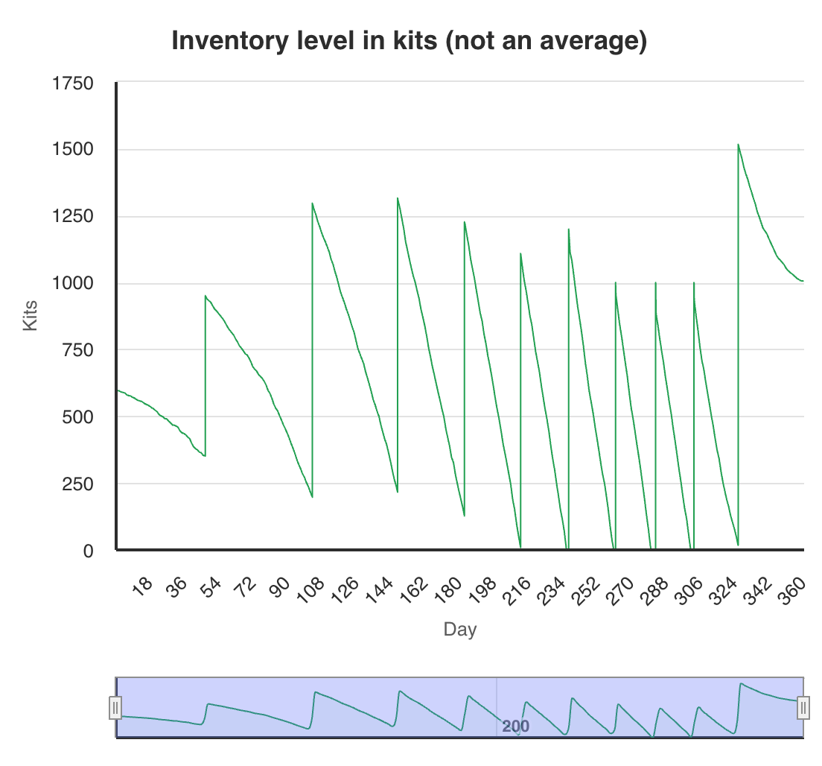
Team F (7th place)
Cash: $1,470,076
S1: 1 → 2 (33) → 4 (34) → 5 (87) → 6 (156) → 7 (188) → 8 (231) → 9 (292) → 7 (339) → 5 (340) → 3 (341) → 2 (344) → 1 (353)
S2: 1 → 2 (64) → 3 (275) → 2 (341) → 1 (342)
S3: 1 (no changes)
1. Capacity Management
- S1: Util > 90 % by day 20 but didn’t add until day 33—should have added a 2ⁿᵈ machine when 7-day avg util > 90 % (~day 20). Subsequent adds (→4@34, →5@87, →6@156, →7@188, →8@231, →9@292) tracked peaks. Late sell-offs (→7@339, →5@340, →3@341, →2@344, →1@353) lagged 7-day avg util < 70 %—trim earlier.
- S2: Added 2ⁿᵈ at day 64 (util ≈ 80 %), 3ʳᵈ at day 275; sold back to one at day 342 (util < 40 %).
- S3: Util < 70 % throughout; one machine sufficed.
2. Contract Strategy
- Switched to C3 (\$250) by day 60 and ran mostly C3 through day 240. Shifted to C2 ($225) briefly around day 260 when queues spiked, then toggled C3/C2 late and ended on C2/C1 as capacity shrank.
3. Inventory Performance
- Stockouts occurred around days 236–237, 261–262, 280–283, and 301–303.
- Leftover ≈ 1,006 kits ($100,600)
Revenue
Inventory

Slide 13
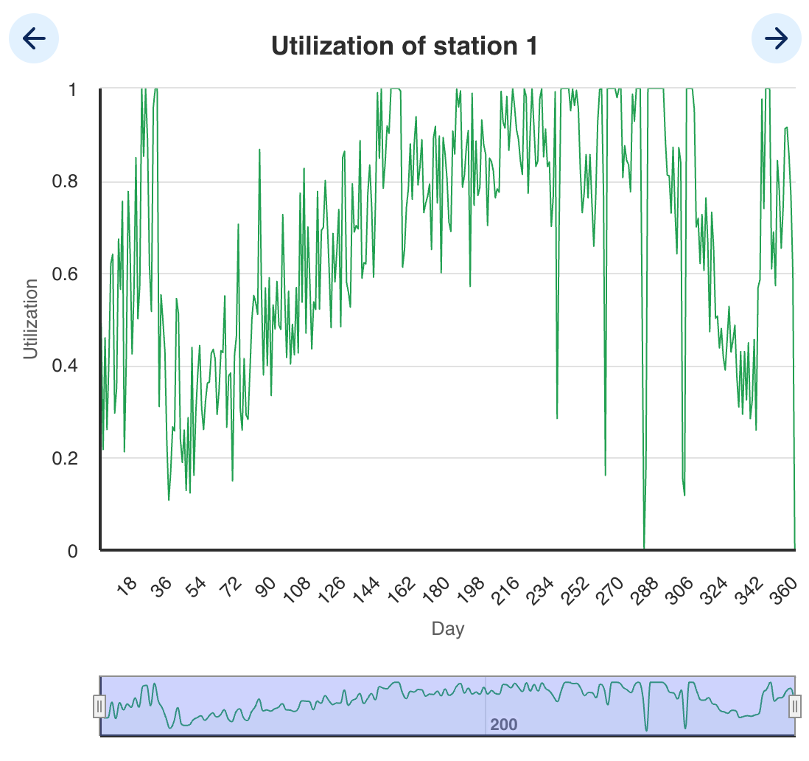
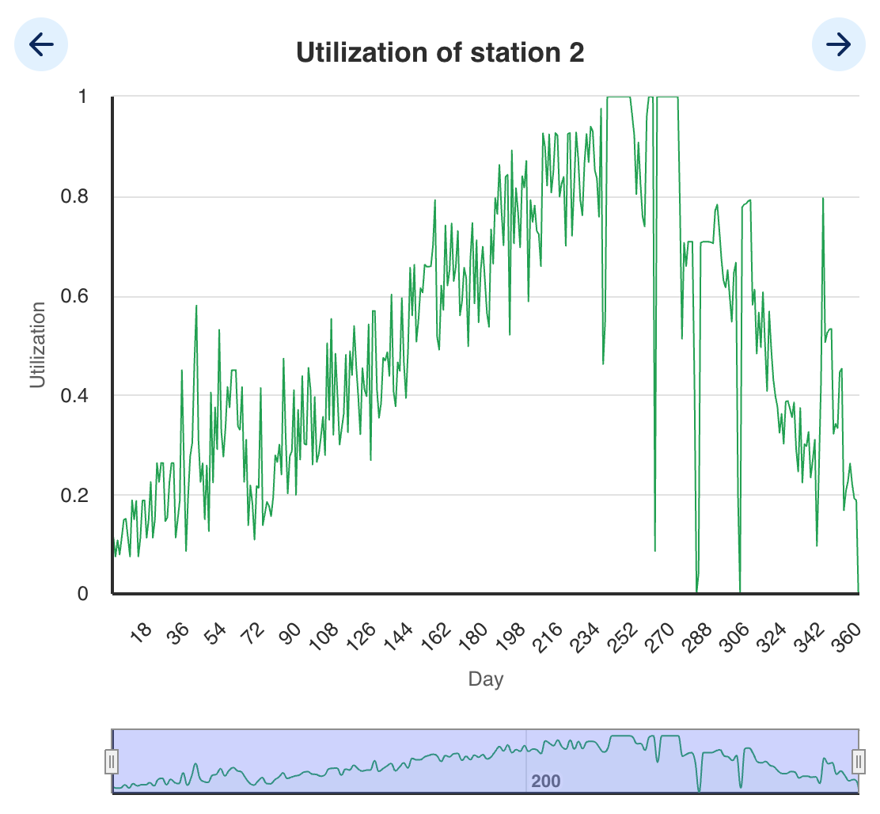
Utilization
Station 1
Station 2

Slide 14
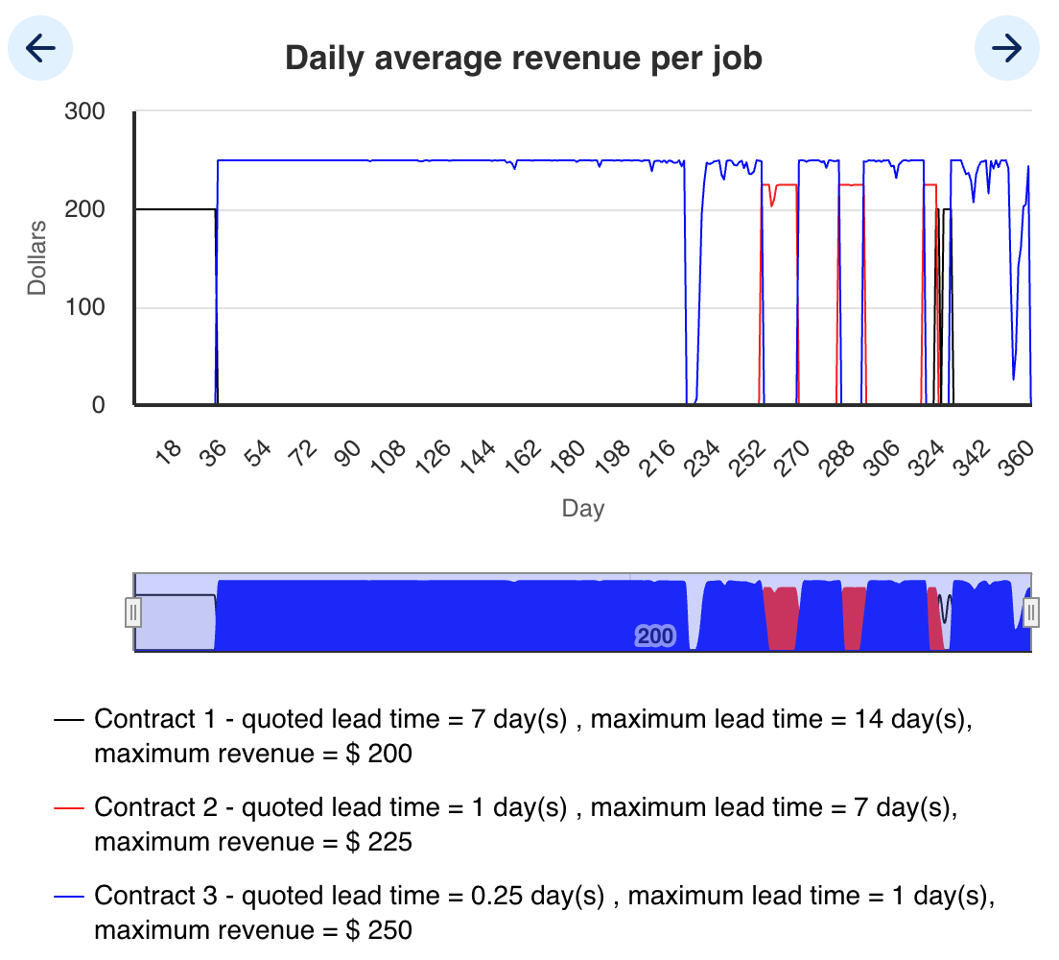
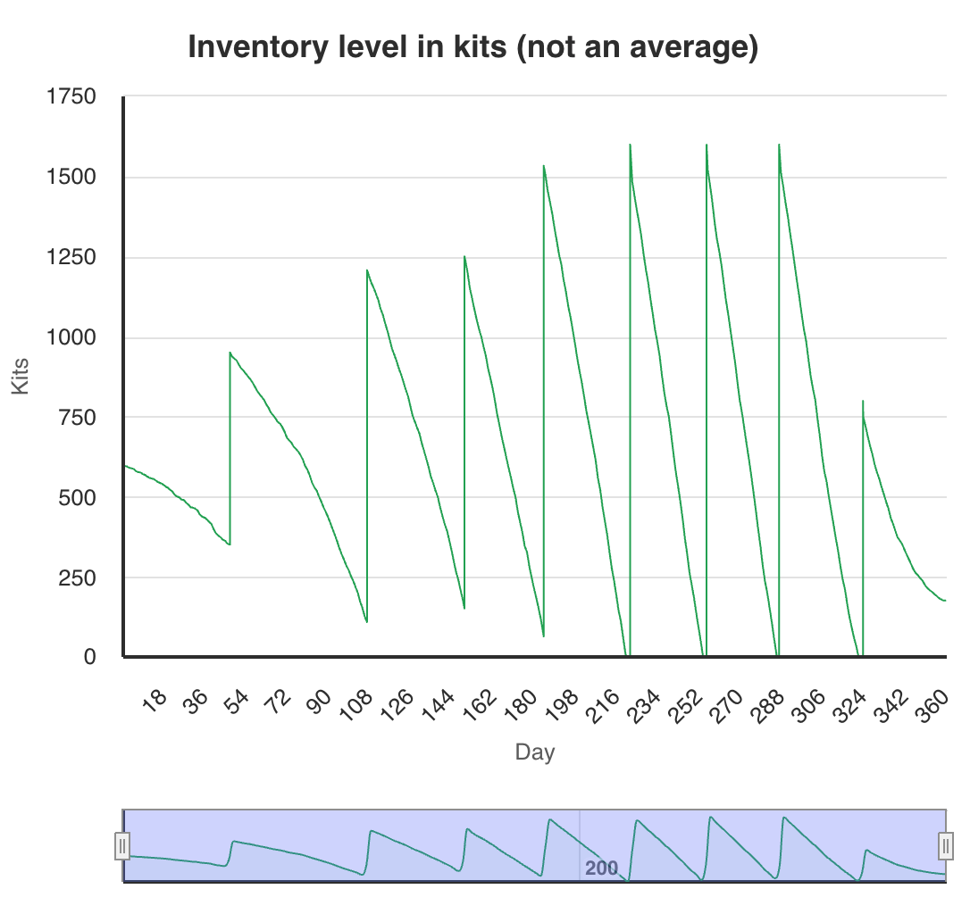
Team H (4th place)
Cash: $1,695,995
S1: 1 → 2 (day 32) → 6 (33) → 7 (129) → 8 (130) → 9 (264) → 8 (331) → 7 (332) → 6 (334) → 4 (335) → 3 (342) → 2 (350) → 1 (351)
S2: 1 → 2 (32) → 3 (154) → 1 (333)
S3: 1 → 2 (156) → 1 (294)
1. Capacity Management
- S1: util >90 % by day 20 but only added 2nd machine at day 32—should have added at 7-day avg util >90 % (~day 20). Subsequent adds (→6@33,→7@129,→8@130,→9@264) tracked demand peaks. Sell-offs (→8@331,→7@332,→6@334,→4@335,→3@342,→2@350,→1@351) lagged 7-day avg util <70 %—could trim earlier.
- S2: added 2ⁿᵈ at day 32 (util≈80 %), 3ʳᵈ at day 154; sold back to one at day 333 (util <40 %).
- S3: util <70 % until day 156; 2ⁿᵈ machine from day 156→294 was idle much of the time—could have skipped until util >90 %.
2. Contract Strategy
- C1→C3 at day 33 (switched to $250/job), held C3 until day 252.
- C3→C2 at day 252 (switched to $225), then C2→C3 at day 266, C3→C2 at day 283, C2→C3 at day 293, C3→C2 at day 317, C2→C1 at day 322, and C1→C3 at day 328.
- Early S1 under-capacity (days 1–32) forced some C3 orders into delays; later toggles between C2/C3 matched utilization swings.
3. Inventory Performance
- Stockouts occurred around days 220–222, 253–255, 286–287, and 321–323—safety stock was too low for mid-run demand spikes.
- Leftover at day 360 ≈ 176 kits (~$17,600)
Inventory
Revenue

Slide 15
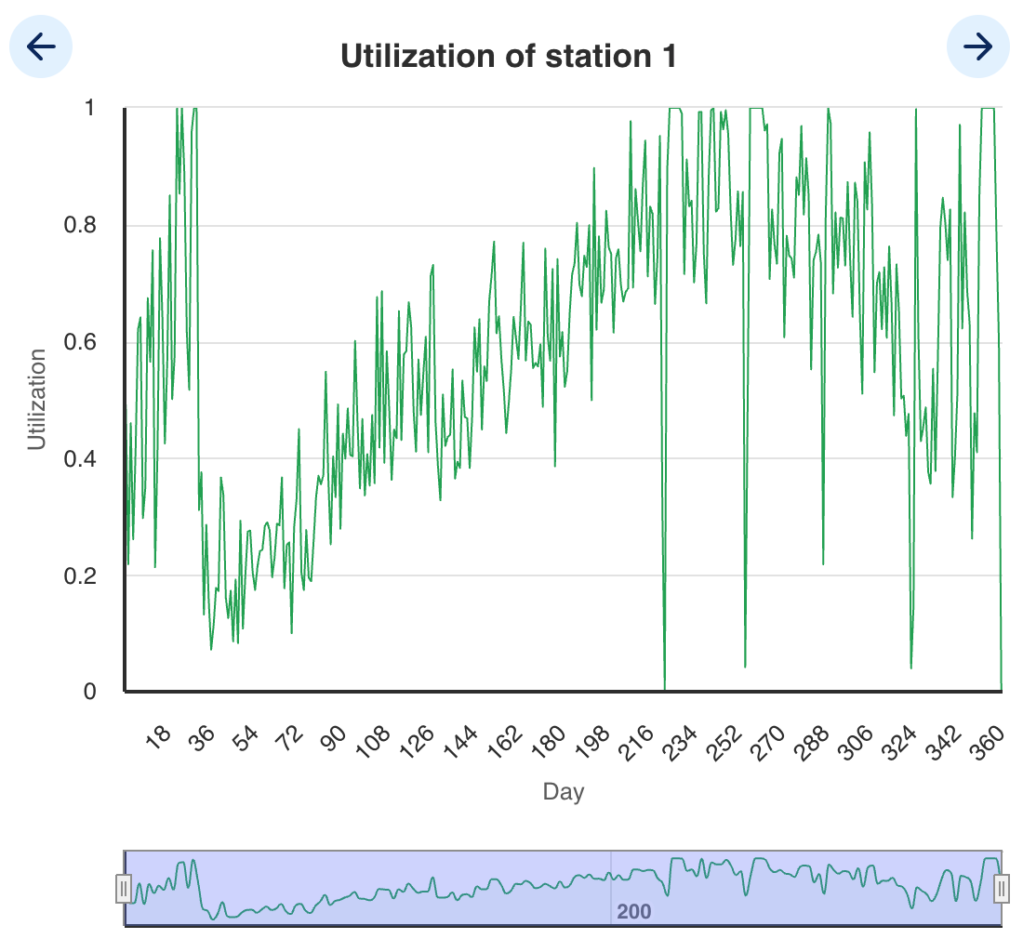
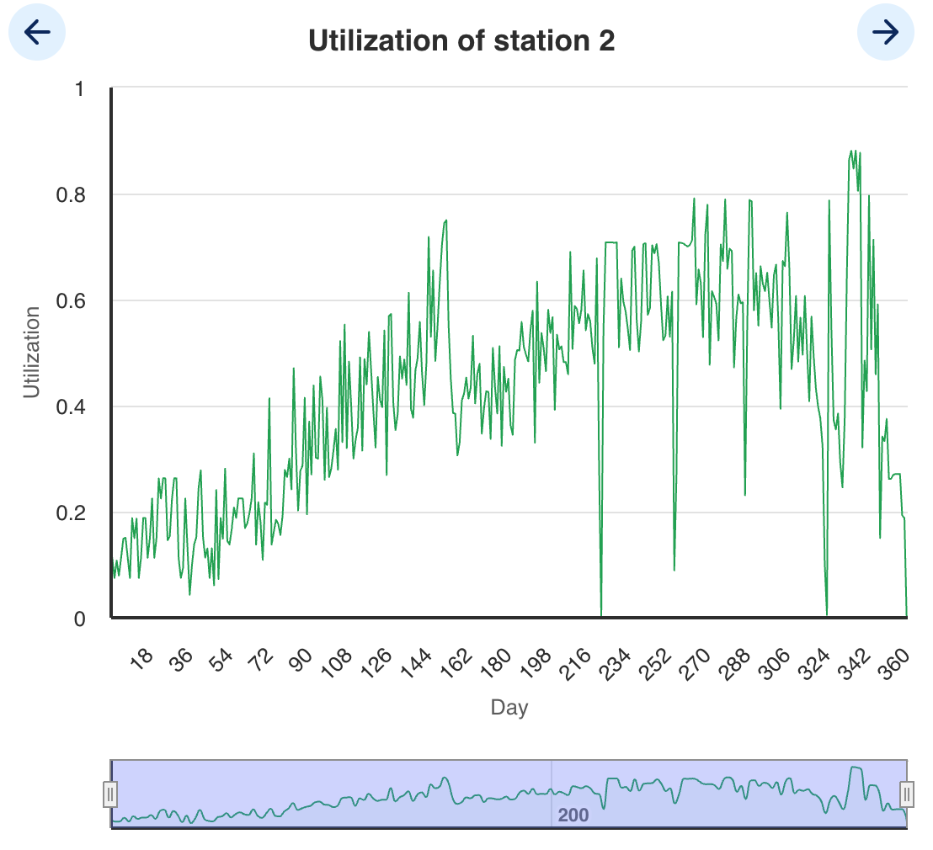
Utilization
Station 1
Station 2

Slide 16
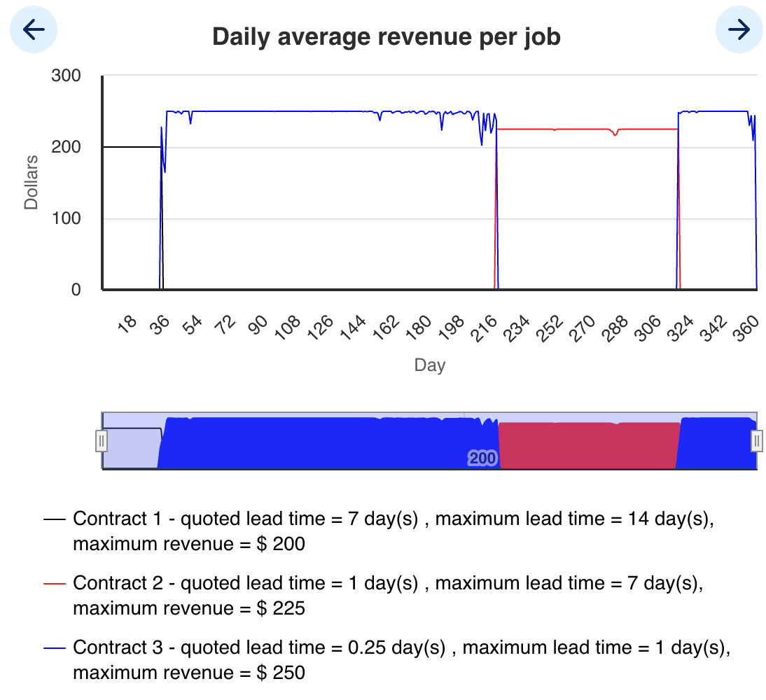
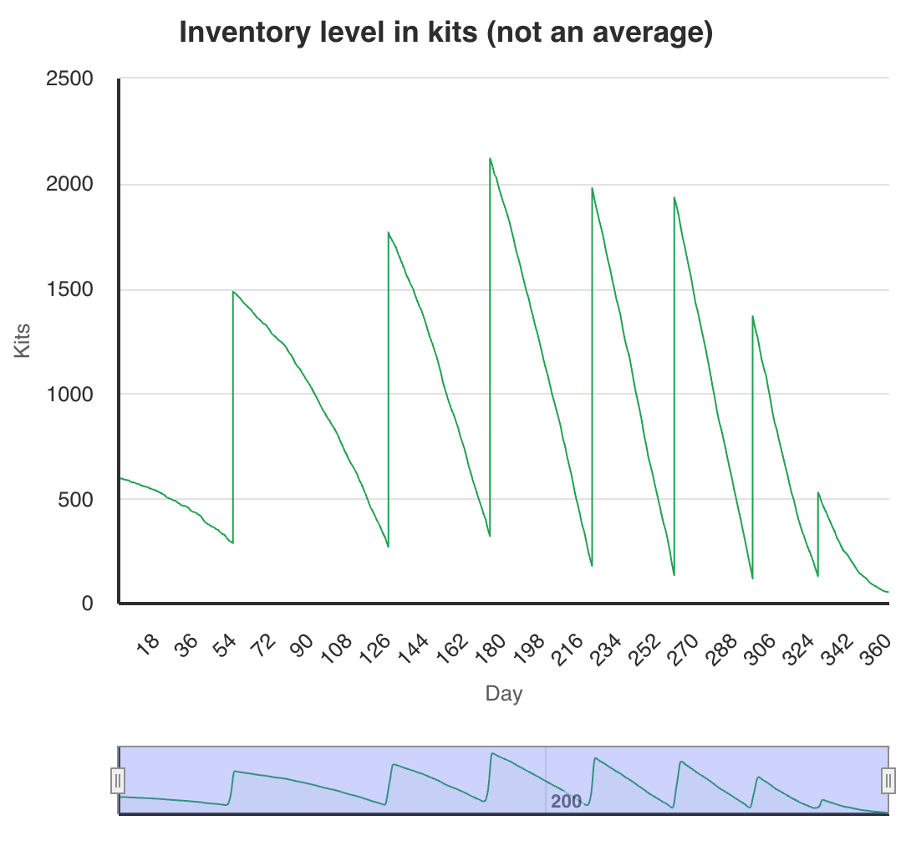
TA1 (Passive… 1-day contract at peak )
Cash: $ 1,869,694
S1: 5 (day 37) → 7(62) → 1(356)
S2: 2(day 50) → 1(357)
Revenue
Inventory
16
16

Slide 17
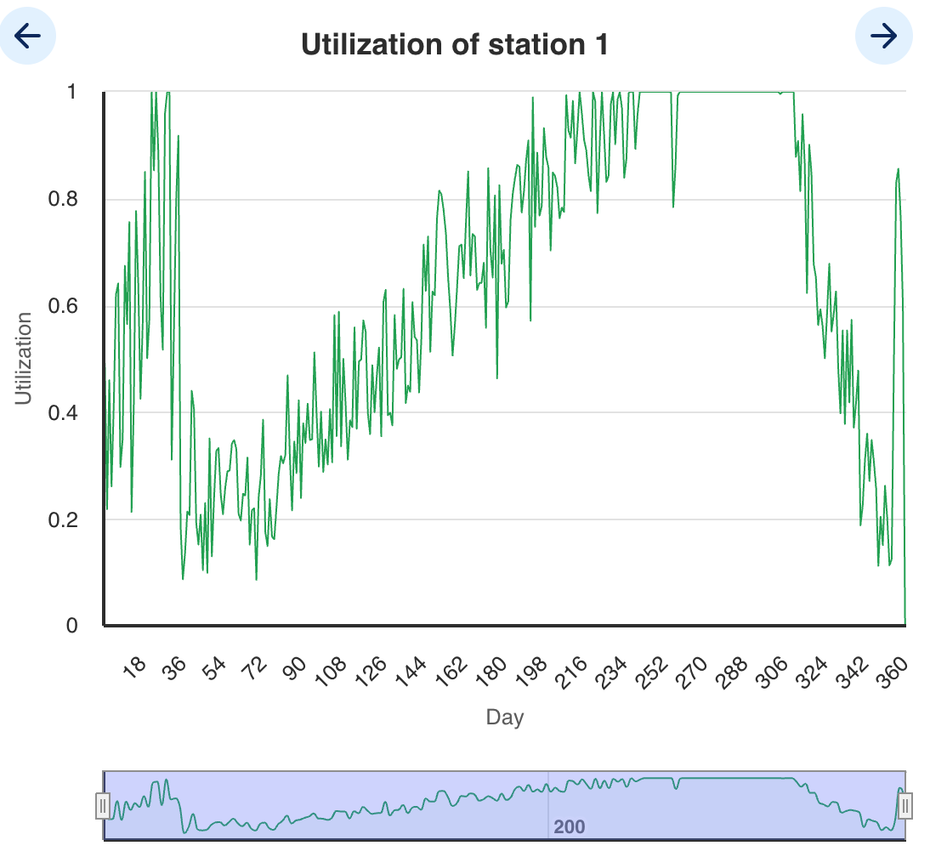
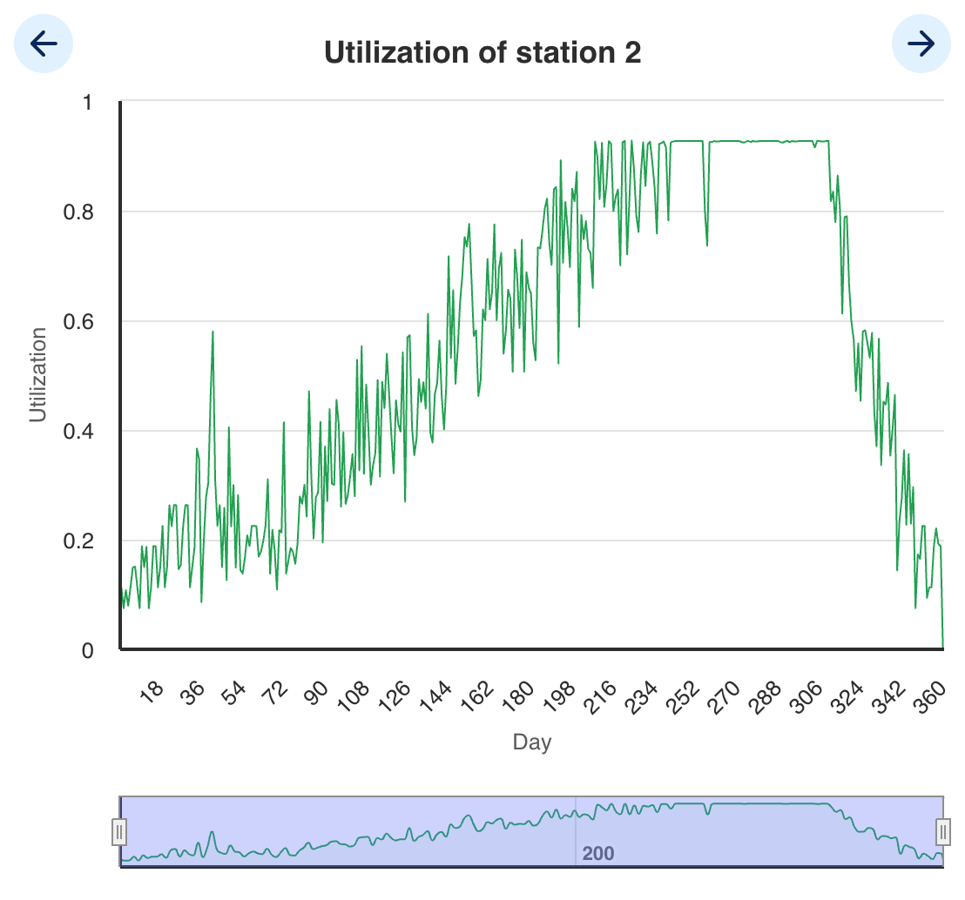
Utilization
Station 1
Station 2

Slide 18
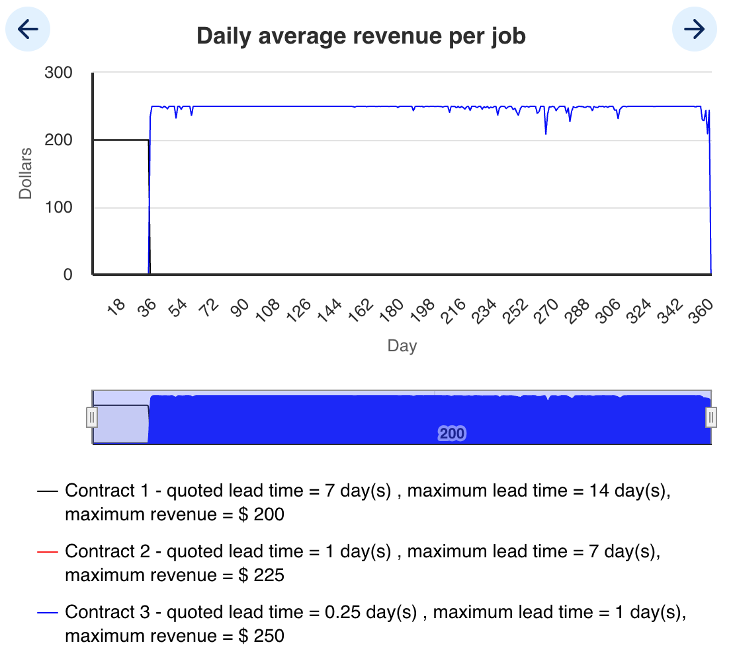
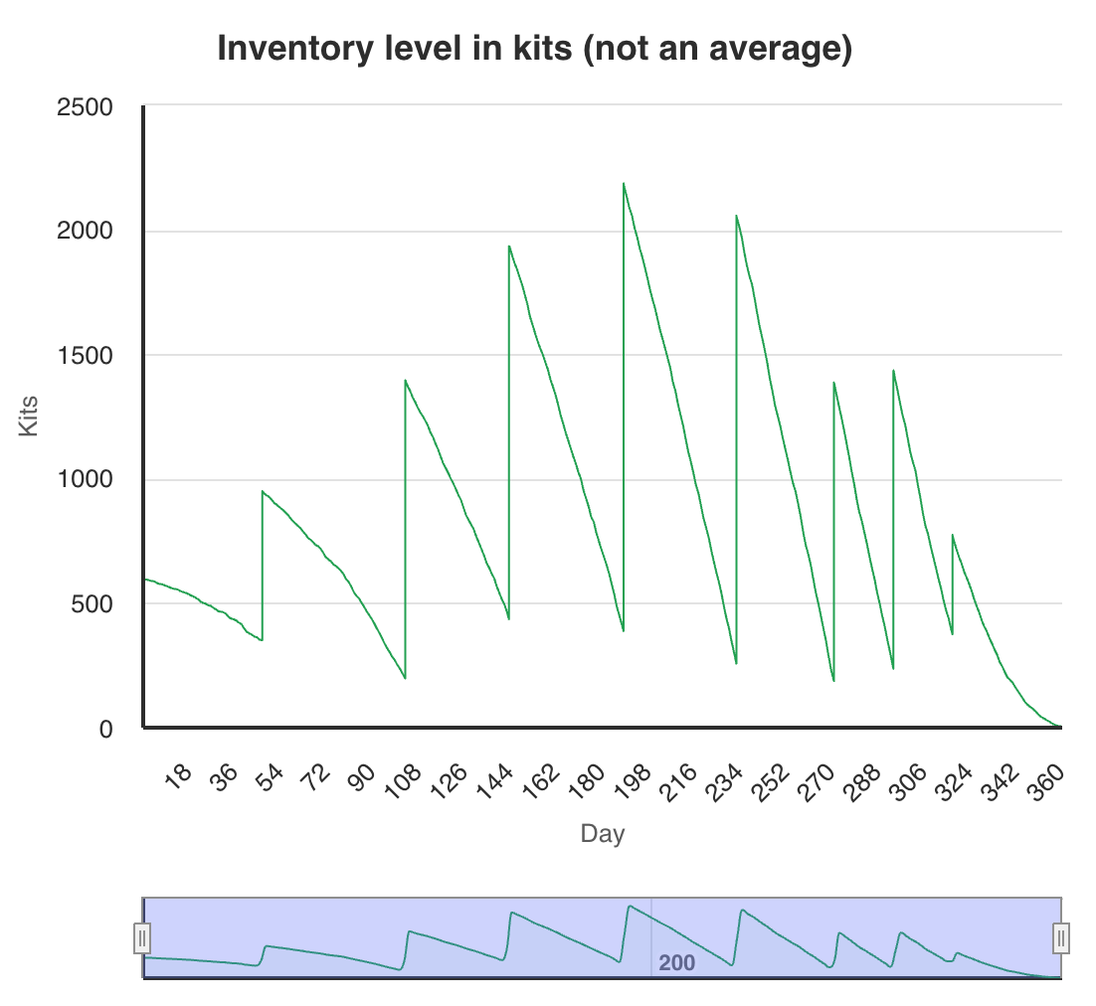
TA2 (Aggressive--- 6 hour contract all the way through)
Cash: $ 1,893,477
S1: 5(day 30) → 9(63) → 6(340) → 4(349) → 1(353)
S2: 2(day 58) → 3(97) → 2(342) → 1(350)
Revenue
Inventory
18
18

Slide 19
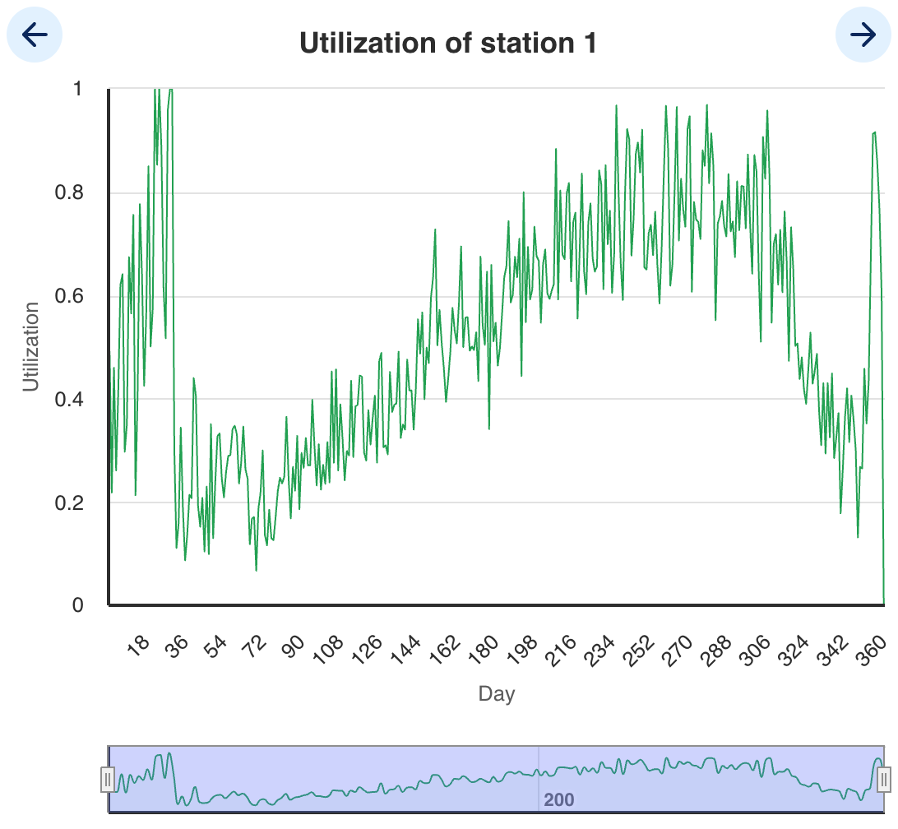
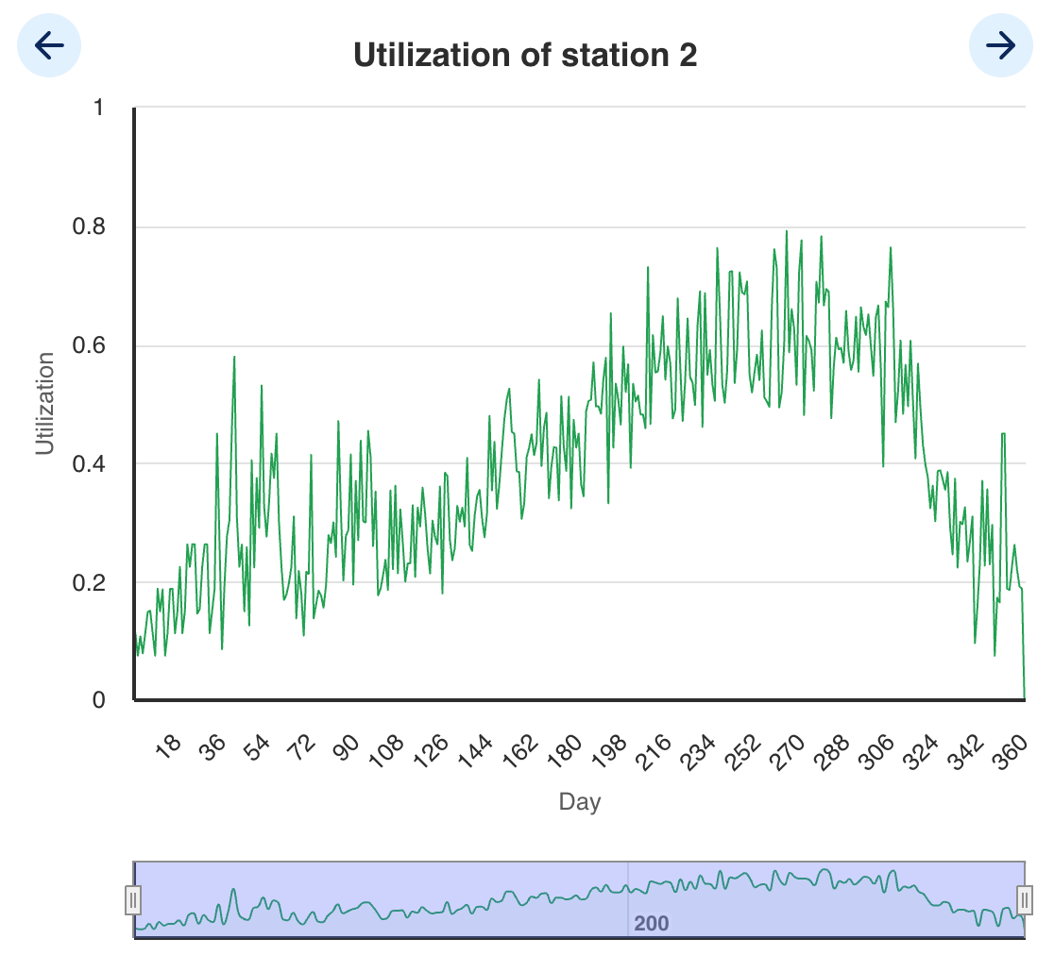
Utilization
Station 1
Station 2

Slide 20
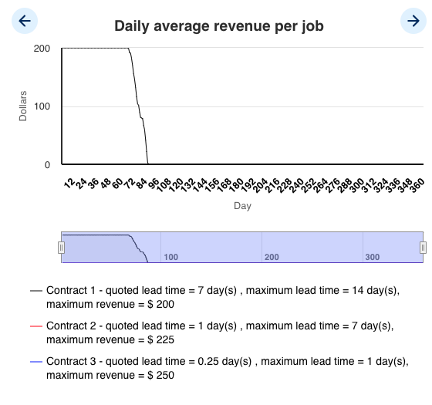
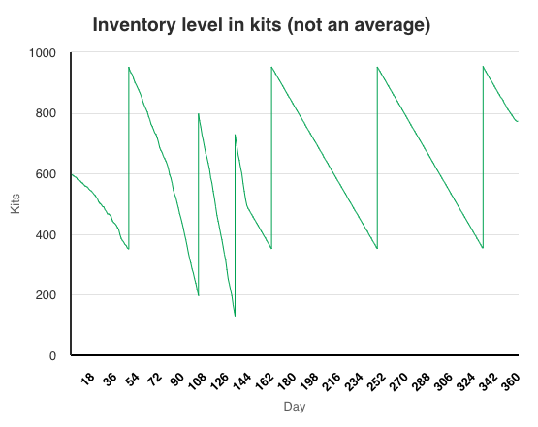
Do Nothing TEAM
Cash: $ 260,812
S1: 1
S2: 1
S3: 1
Revenue
Inventory

Slide 21
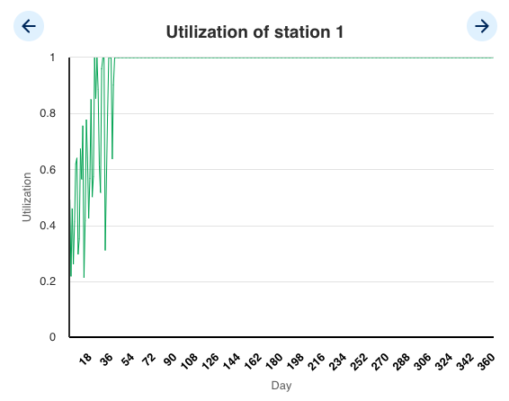
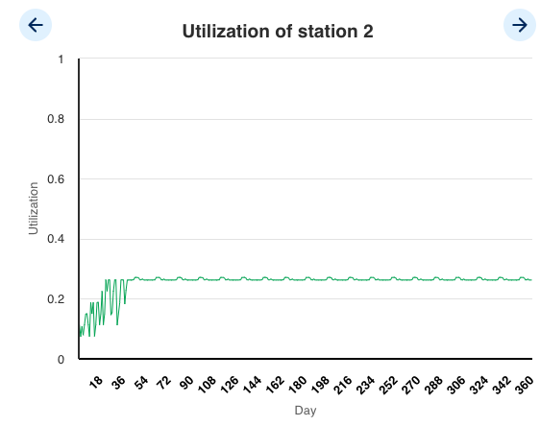
Utilization
Station 1
Station 2

